Slide 1
Modern Systems Analysis
and Design
Seventh Edition
Jeffrey A. Hoffer
Joey F. George
Joseph S. Valacich
Chapter 1
The Systems Development Environment

Slide 2
Learning Objectives
Define information systems analysis and design.
Describe the different types of information systems.
Describe the information systems development life cycle (SDLC).
Explain Rapid Application Development (RAD) and computer-aided software engineering (CASE) tools.
Describe Agile Methodologies and eXtreme Programming.
Explain object-oriented analysis and design and the Rational Unified Process (RUP).
Chapter 1
Copyright © 2014 Pearson Education, Inc. Publishing as Prentice Hall

Slide 3
System
A system is an interrelated set of components with an identifiable boundary working together for some purpose
A system has nine characteristics.
  Components
  Interrelated Components
  A boundary
  A purpose
  An environment
  Interfaces
  Constraints
  Input
  Output
Chapter 1
Copyright © 2014 Pearson Education, Inc. Publishing as Prentice Hall

Slide 4
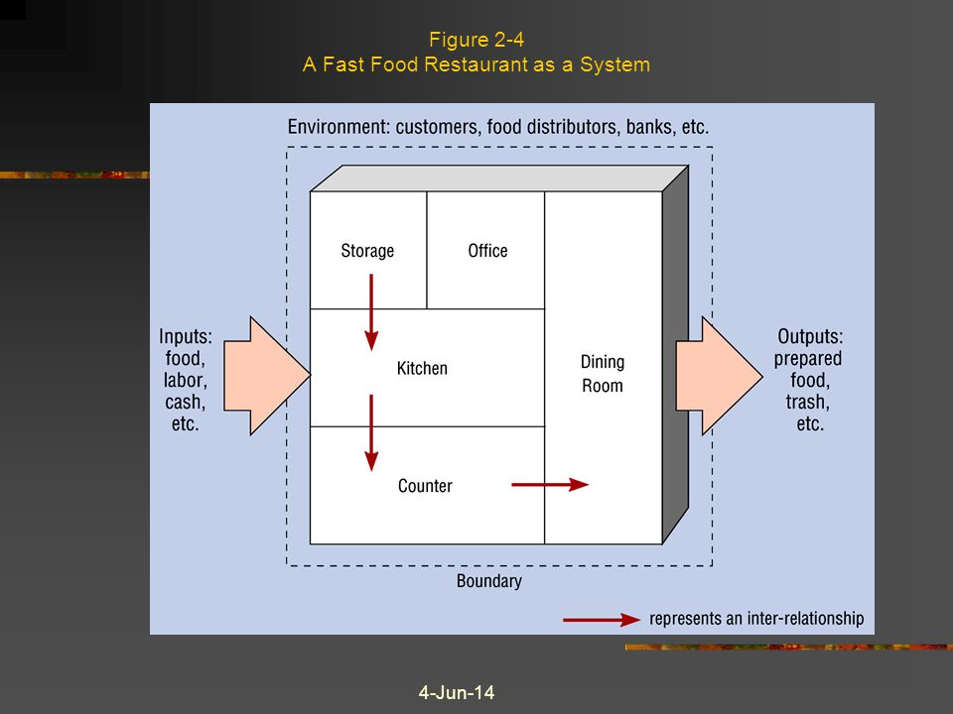
System (Cont.)
11/07/26Chapter 1
Copyright © 2014 Pearson Education, Inc. Publishing as Prentice Hall

Slide 5
Information System (IS)
Information system is an application software to turn data into information and include:
  Hardware and system software
  Documentation and training materials
  Job roles associated with the system
  Controls to prevent theft or fraud
  The people who use the software to perform their jobs
11/07/26Chapter 1
Copyright © 2014 Pearson Education, Inc. Publishing as Prentice Hall

Slide 6
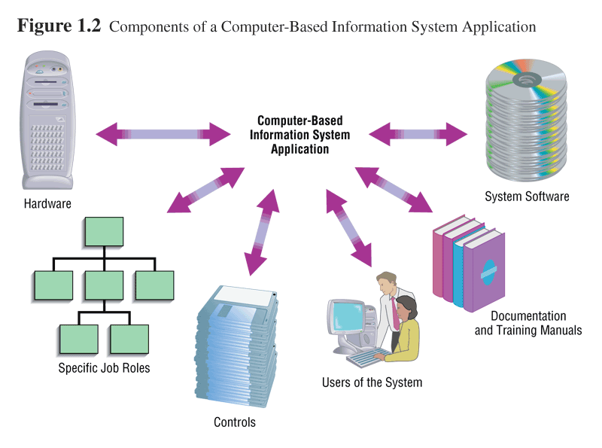
Information System (IS) [Cont.]
11/07/26Chapter 1
Copyright © 2014 Pearson Education, Inc. Publishing as Prentice Hall

Slide 7
Important System Concepts
Decomposition: breaking down a system into smaller constituents
Modularity: the result of decomposition; parts of a system
Coupling: dependencies between subsystems
Cohesion: extent to which a subsystem performs a single function
11/07/26Chapter 1
Copyright © 2014 Pearson Education, Inc. Publishing as Prentice Hall

Slide 8
Information Systems Analysis and Design
Complex organizational process
Used to develop and maintain computer-based information systems
Used by a team of business and systems professionals
Chapter 1
Copyright © 2014 Pearson Education, Inc. Publishing as Prentice Hall

Slide 9
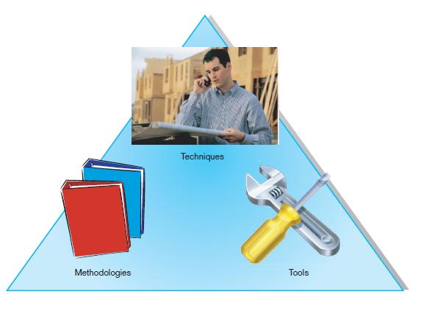
Information Systems Analysis and Design (Cont.)
FIGURE 1-1 An organizational approach to systems analysis and
design is driven by methodologies, techniques, and tools
Chapter 1
Copyright © 2014 Pearson Education, Inc. Publishing as Prentice Hall

Slide 10
Information Systems Analysis and Design (Cont.)
A Methodologies
  A sequence of step-by-step approaches that help develop the information system
Techniques
  Processes that the analyst follows to ensure thorough, complete, and comprehensive analysis and design
Tools
  Computer programs that aid in applying techniques
Chapter 1
Copyright © 2014 Pearson Education, Inc. Publishing as Prentice Hall

Slide 11
Information Systems Analysis and Design (Cont.)
Application Software
  Computer software designed to support organizational functions or processes
Systems Analyst
  Organizational role most responsible for analysis and design of information systems
Chapter 1
Copyright © 2014 Pearson Education, Inc. Publishing as Prentice Hall

Slide 12
Types of Information systems
Transaction Processing System (TPS)
  To process large amounts of data for routine business transactions such as Payroll and Inventory applications.
  Database is required.
  TPS eliminate manual work and reduce transaction-processing time
  Support managers to look at the data generated by TPS to see what is happening at their companies.
  Process orientation
11/07/26Chapter 1
Copyright © 2014 Pearson Education, Inc. Publishing as Prentice Hall

Slide 13
Types of Information systems (cont.)
Office Automation (OAS) and Knowledge Work Systems (KWS)
  OAS support data workers, who do not usually create new knowledge but rather analyze information.
  OAS applications include: Word-processing, Spreadsheets and e-mail/ voice mail.
  KWS support professional workers (scientist, engineers and doctors) to create new knowledge (Ex: CAD systm)
11/07/26Chapter 1
Copyright © 2014 Pearson Education, Inc. Publishing as Prentice Hall

Slide 14
Types of Information systems (cont.)
Management Information System (MIS)
  Converts raw data from transaction processing system (TPS) into meaningful form
  MIS summarizes data to help managers taking a decision.
  MIS often requires data from several TPSs.
  Data orientation
11/07/26Chapter 1
Copyright © 2014 Pearson Education, Inc. Publishing as Prentice Hall

Slide 15
Types of Information systems (cont.)
  Decision Support System (DSS)
  Designed to help decision makers
  Provides interactive environment for decision making (What if?)
  Composed of database, user interface (dialogue model) and mathematical or graphical model of business process
  Data and decision logic orientation
11/07/26Chapter 1
Copyright © 2014 Pearson Education, Inc. Publishing as Prentice Hall

Slide 16
Developing Information Systems
System Development Methodology is a standard process followed in an organization to conduct all the steps necessary to analyze, design, implement, and maintain information systems.
Chapter 1
Copyright © 2014 Pearson Education, Inc. Publishing as Prentice Hall

Slide 17
Systems Development Life Cycle (SDLC)
Traditional methodology used to develop, maintain, and replace information systems
Phases in SDLC:
  Planning
  Analysis
  Design
  Implementation
  Maintenance
Chapter 1
Copyright © 2014 Pearson Education, Inc. Publishing as Prentice Hall

Slide 18
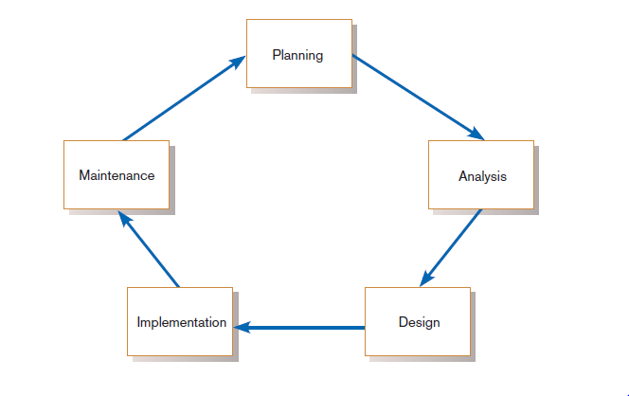
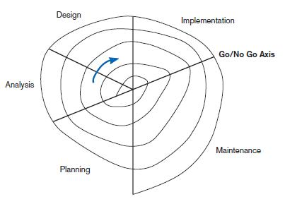
Standard and Evolutionary Views of SDLC
FIGURE 1-3 Evolutionary model
FIGURE 1-2
Systems development life cycle
Chapter 1
Copyright © 2014 Pearson Education, Inc. Publishing as Prentice Hall

Slide 19
Systems Development Life Cycle (SDLC) (Cont.)
Planning – an organization’s total information system needs are identified, analyzed, prioritized, and arranged
Analysis – system requirements are studied and structured
Design – a description of the recommended solution is converted into logical and then physical system specifications
Chapter 1
Copyright © 2014 Pearson Education, Inc. Publishing as Prentice Hall

Slide 20
Systems Development Life Cycle (SDLC) (Cont.)
Logical design – all functional features of the system chosen for development in analysis are described independently of any computer platform
Physical design – the logical specifications of the system from logical design are transformed into the technology-specific details from which all programming and system construction can be accomplished
Chapter 1
Copyright © 2014 Pearson Education, Inc. Publishing as Prentice Hall

Slide 21
Systems Development Life Cycle (SDLC) (Cont.)
Implementation – the information system is coded, tested, installed and supported in the organization
Maintenance – an information system is systematically repaired and improved
Chapter 1
Copyright © 2014 Pearson Education, Inc. Publishing as Prentice Hall

Slide 22
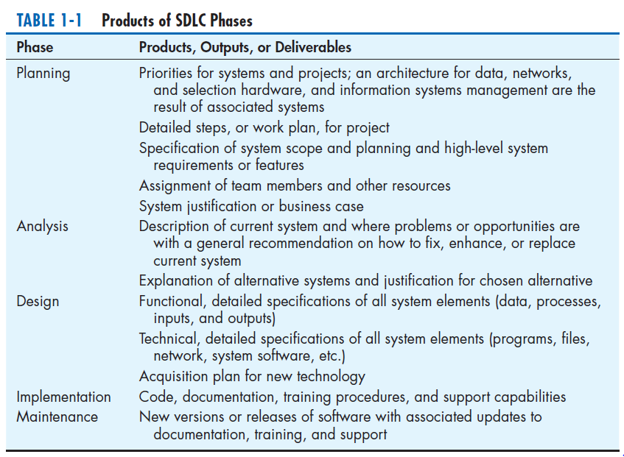
Chapter 1
Copyright © 2014 Pearson Education, Inc. Publishing as Prentice Hall

Slide 23
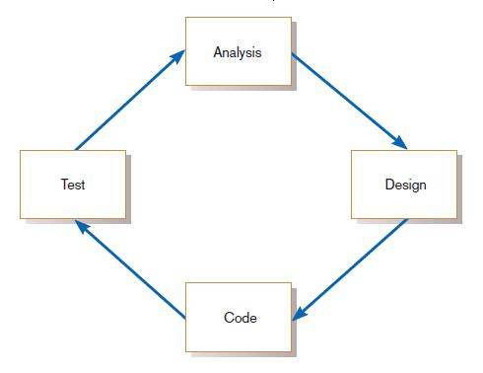
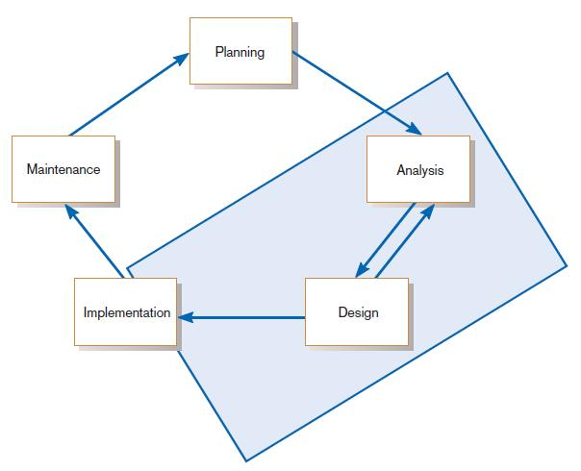
The Heart of the Systems Development Process
FIGURE 1-8
Analysis–design–code–test loop
FIGURE 1-9
The heart of systems development
Current practice combines analysis, design, and implementation into a single iterative and parallel process of activities.
Chapter 1
Copyright © 2014 Pearson Education, Inc. Publishing as Prentice Hall

Slide 24
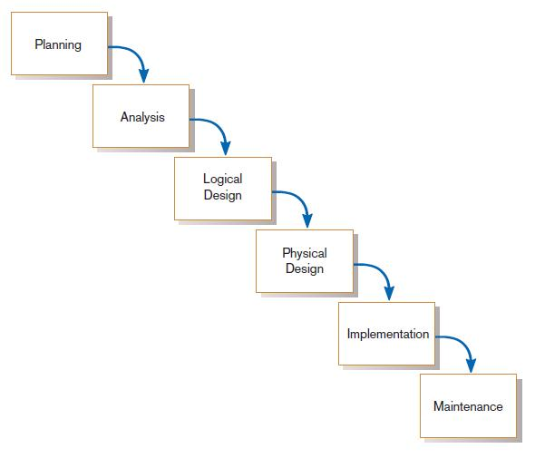
Traditional Waterfall SDLC
One phase begins when another completes, with little backtracking and looping.
FIGURE 1-10
Traditional waterfall SDLC
Chapter 1
Copyright © 2014 Pearson Education, Inc. Publishing as Prentice Hall

Slide 25
Problems with Waterfall Approach
Feedback ignored, milestones lock in design specs even when conditions change
Limited user involvement (only in requirements phase)
Too much focus on milestone deadlines of SDLC phases to the detriment of sound development practices
Chapter 1
Copyright © 2014 Pearson Education, Inc. Publishing as Prentice Hall

Slide 26
Different Approaches to Improving Development
CASE Tools
Rapid Application Development (RAD)
Agile Methodologies
eXtreme Programming
Chapter 1
Copyright © 2014 Pearson Education, Inc. Publishing as Prentice Hall

Slide 27
Computer-Aided Software Engineering (CASE) Tools
Diagramming tools enable graphical representation.
Computer displays and report generators help prototype how systems “look and feel”.
IBM’s Rational products are the best known CASE tools.
Chapter 1
Copyright © 2014 Pearson Education, Inc. Publishing as Prentice Hall

Slide 28
Computer-Aided Software Engineering (CASE) Tools (Cont.)
Analysis tools automatically check for consistency in diagrams, forms, and reports.
A central repository provides integrated storage of diagrams, reports, and project management specifications.
Chapter 1
Copyright © 2014 Pearson Education, Inc. Publishing as Prentice Hall

Slide 29
Computer-Aided Software Engineering (CASE) Tools (Cont.)
Documentation generators standardize technical and user documentation.
Code generators enable automatic generation of programs and database code directly from design documents, diagrams, forms, and reports.
Chapter 1
Copyright © 2014 Pearson Education, Inc. Publishing as Prentice Hall

Slide 30
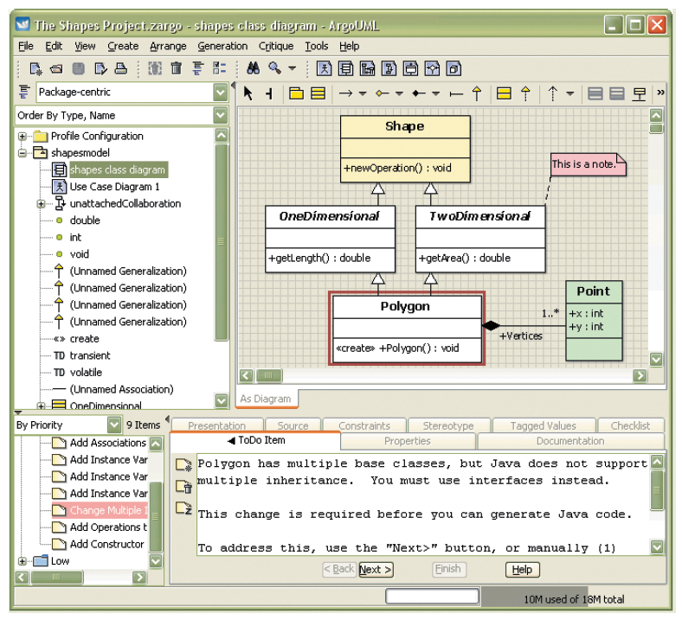
CASE Tools (Cont.)
FIGURE 1-11
Screen shot of ArgoUML, an open source CASE tool
(Source: http://argouml.tigris.org/)
Chapter 1
Copyright © 2014 Pearson Education, Inc. Publishing as Prentice Hall

Slide 31
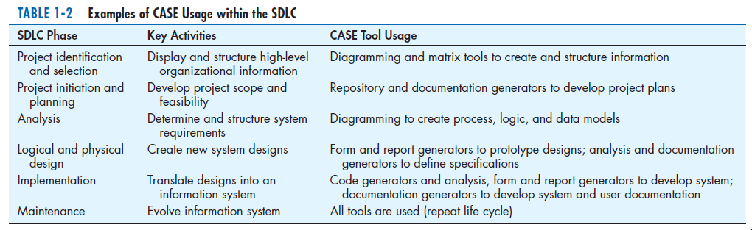
CASE Tools (Cont.)
Chapter 1
Copyright © 2014 Pearson Education, Inc. Publishing as Prentice Hall

Slide 32
Rapid Application Development (RAD)
Decreases design and implementation time
Involves: extensive user involvement, prototyping, integrated CASE tools, code generators
More focus on user interface and system function, less on detailed business analysis and system performance
Chapter 1
Copyright © 2014 Pearson Education, Inc. Publishing as Prentice Hall

Slide 33
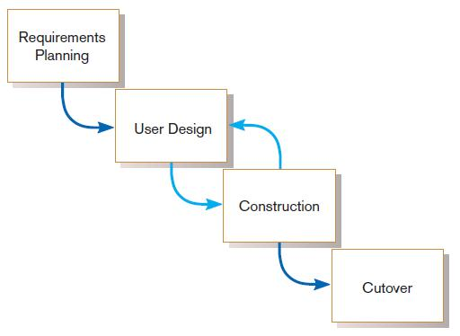
Rapid Application Development (RAD) (Cont.)
FIGURE 1-12
RAD life cycle
Chapter 1
Copyright © 2014 Pearson Education, Inc. Publishing as Prentice Hall

Slide 34
Agile Methodologies
Motivated by recognition of software development as fluid, unpredictable, and dynamic
Three key principles
  Adaptive rather than predictive
  Emphasize people rather than roles
  Self-adaptive processes
Chapter 1
Copyright © 2014 Pearson Education, Inc. Publishing as Prentice Hall

Slide 35
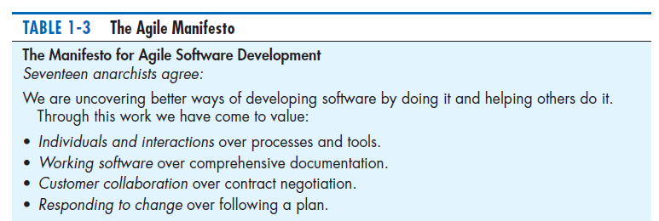
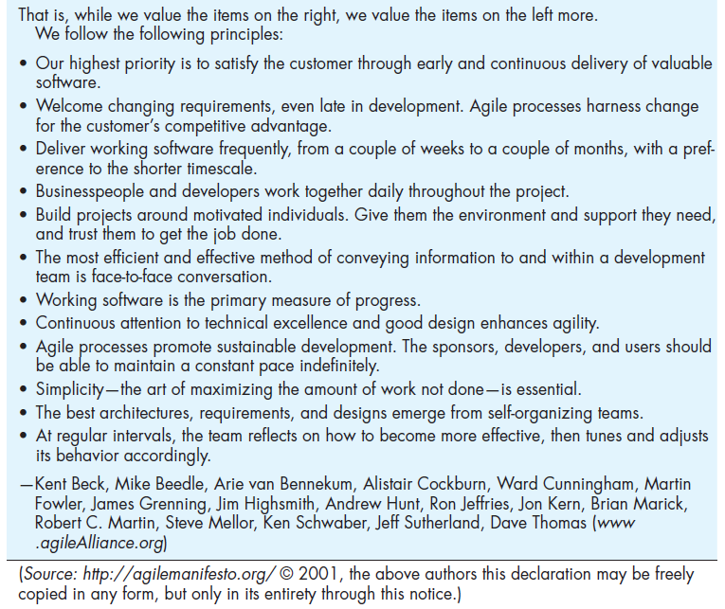
The Agile Methodologies group argues that software development methodologies
adapted from engineering generally do not fit with real-world software development.
Chapter 1
Copyright © 2014 Pearson Education, Inc. Publishing as Prentice Hall

Slide 36
When to use Agile Methodologies
If your project involves:
  Unpredictable or dynamic requirements
  Responsible and motivated developers
  Customers who understand the process and will get involved
Chapter 1
Copyright © 2014 Pearson Education, Inc. Publishing as Prentice Hall

Slide 37
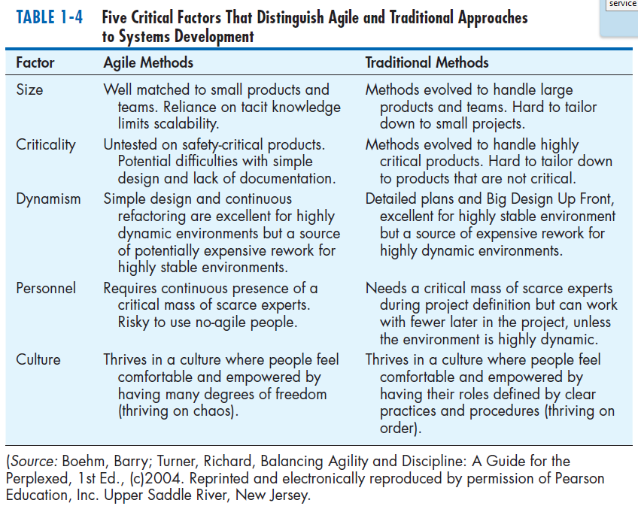
Chapter 1
Copyright © 2014 Pearson Education, Inc. Publishing as Prentice Hall

Slide 38
eXtreme Programming
Short, incremental development cycles
Automated tests
Two-person programming teams
Coding, testing, listening, designing
Chapter 1
Copyright © 2014 Pearson Education, Inc. Publishing as Prentice Hall

Slide 39
eXtreme Programming (Cont.)
Coding and testing operate together
Advantages:
  Communication between developers
  High level of productivity
  High-quality code
Chapter 1
Copyright © 2014 Pearson Education, Inc. Publishing as Prentice Hall

Slide 40
The End
11/07/26Chapter 1
Copyright © 2014 Pearson Education, Inc. Publishing as Prentice Hall

